Slide 1
Geometric Position Control of an UAV
Rishab Shah
April 27, 2017

Slide 2
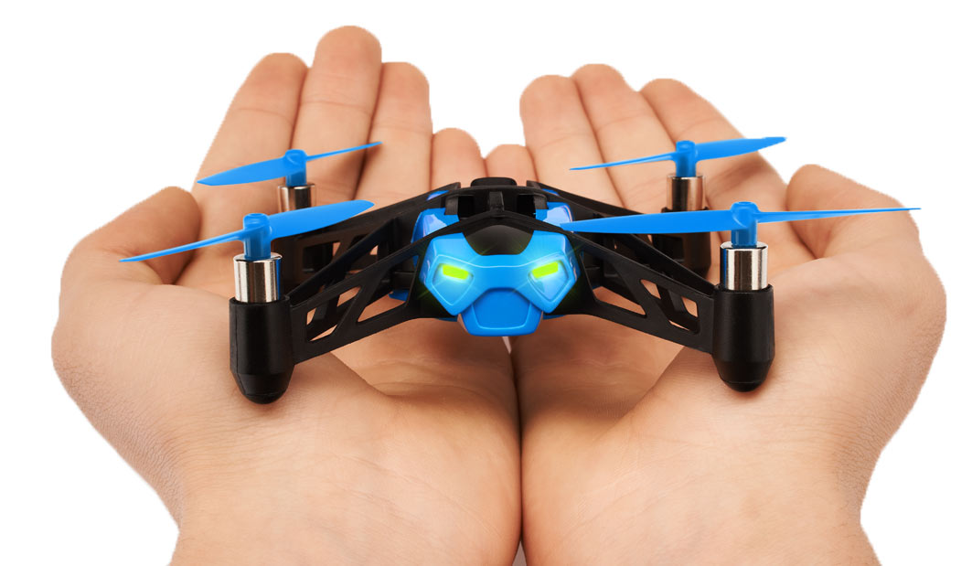
What is Geometric Control?
Development of control systems for dynamical systems.
These systems are usually evolving on non-linear manifolds (e.g., SE(3)).
Cannot be globally identified on Euclidean spaces.
Parrot® Rolling Spider
Mini Drone
http://global.parrot.com/static/images/theme/catalog/rolling_spider/rolling_hand.jpg 2017.

Slide 3
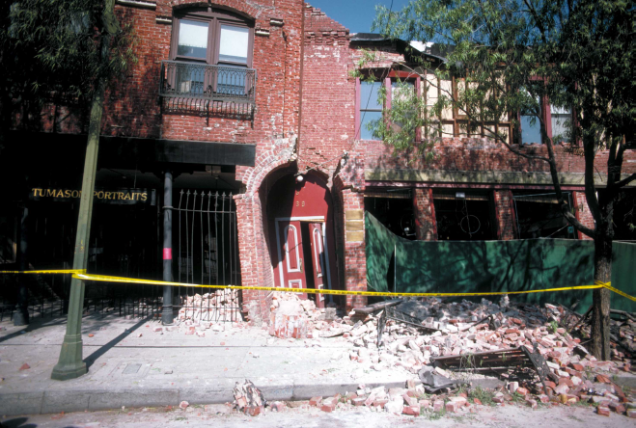
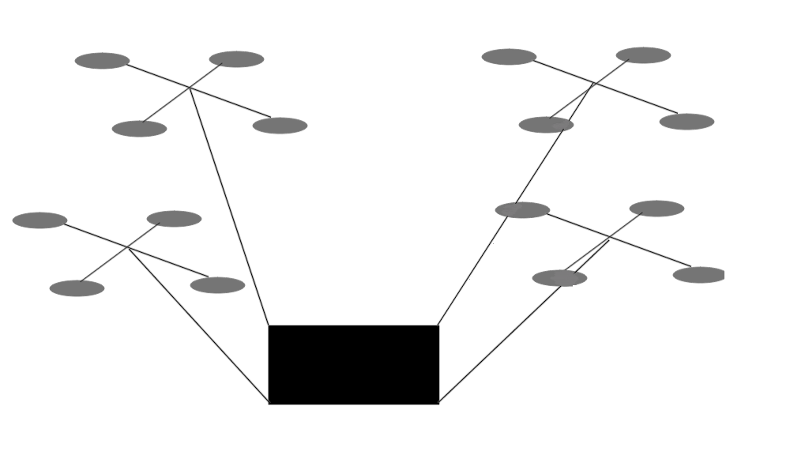
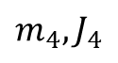
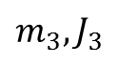
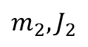
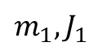
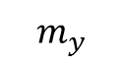
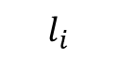
Motivation
Useful for complex, acrobatic maneuvers.
Controls an under actuated UAV with six degrees of freedom with only four thrust inputs.
$$m_{3},J_{3}$$
$$m_{2},J_{2}$$
$$m_{1},J_{1}$$
$$l_{i}$$
$$m_{4},J_{4}$$
$$m_{y}$$
A partially collapsed building after an earthquake.
J.K. Nakata, U.S. Geological Survey

Slide 4
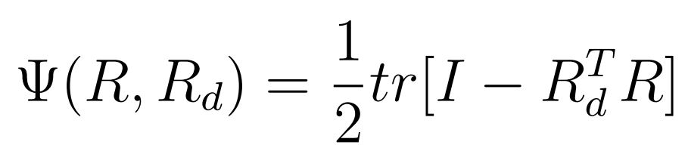
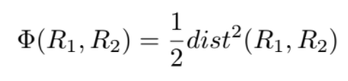
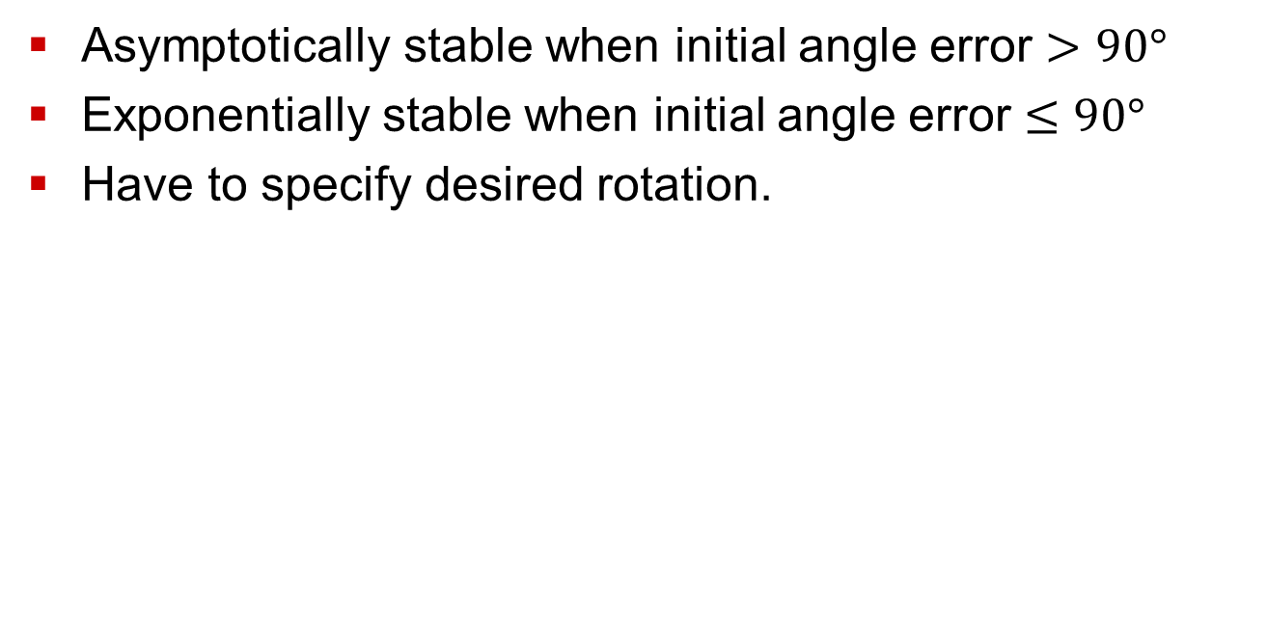
Prior Work
Asymptotically stable when initial angle error $>$ $90°$
Exponentially stable when initial angle error $≤90°$
Have to specify desired rotation.
Cost function proposed
by Taeyoung Lee,
Melvin Leoky, and
N. Harris McClamroch
New controller cost function
T. Lee, M. Leok, and N. McClamroch. Control of complex maneuvers for a quadrotor UAV using geometric methods on SE (3). arXiv preprint arXiv:1003.2005, (3):1–32, 2010.

Slide 5
Error reduction
As the attitude tracking error increases at any time, the direction of the control input term of the translational dynamics deviates from the desired direction.
This may cause instability in the dynamics.
Position tracking error converges to zero when there is no attitude tracking error.
It is adjusted to have exponential stability on the position control for all angle errors.

Slide 6
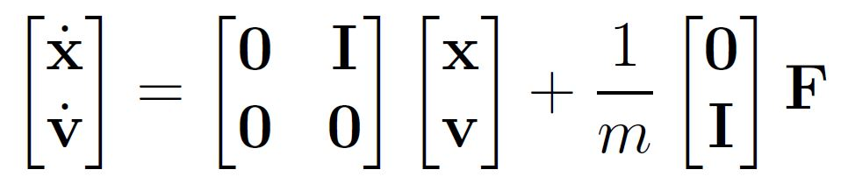
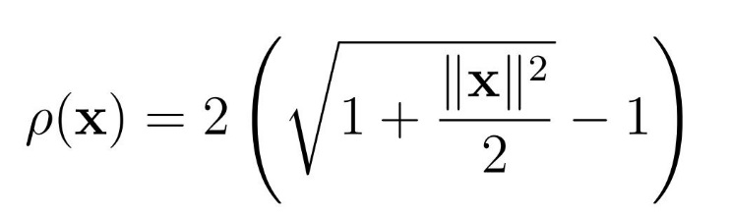
Point Mass in SE(3)

Slide 7
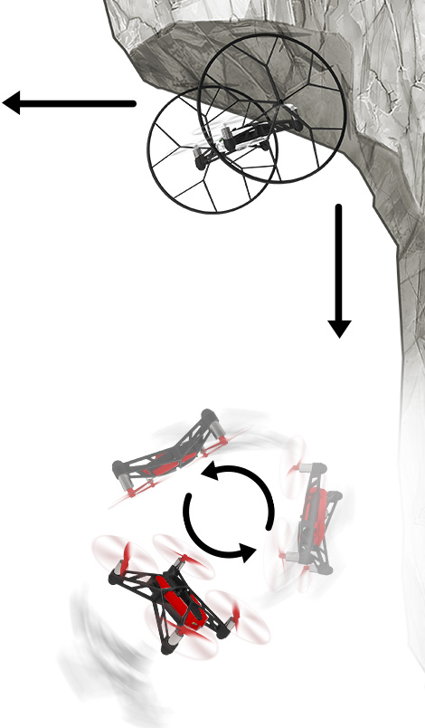



Work Process
Working with Parrot Rolling Spider Mini Drone.
Based on Simulink model.
Implementing simple controllers on the drone
in real time, such as
PID control
Full state feedback
LQR control
http://global.parrot.com/au/products/rolling-spider/

Slide 8
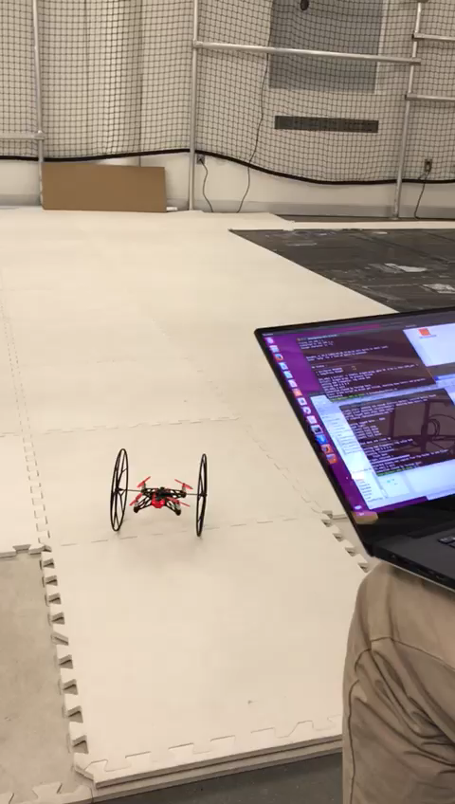
Results
Failure without
optical flow

Slide 9
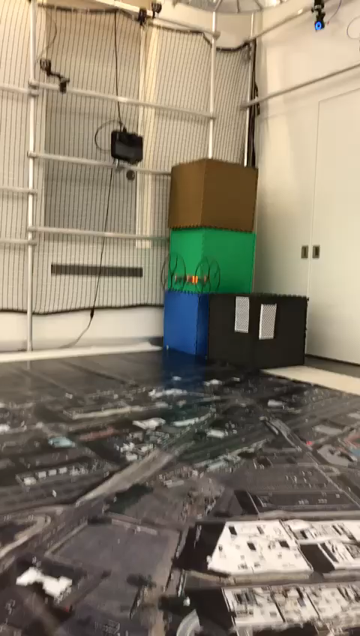
Results
Success

Slide 10
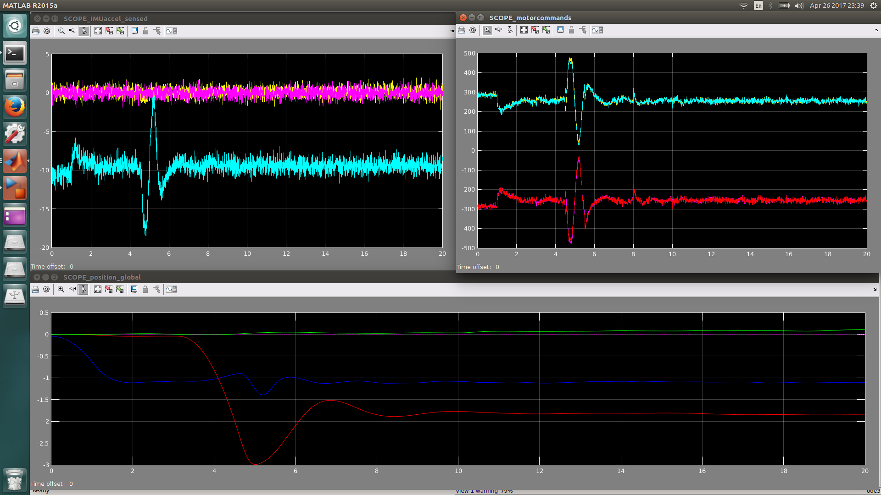
Results
PID Control

Slide 11
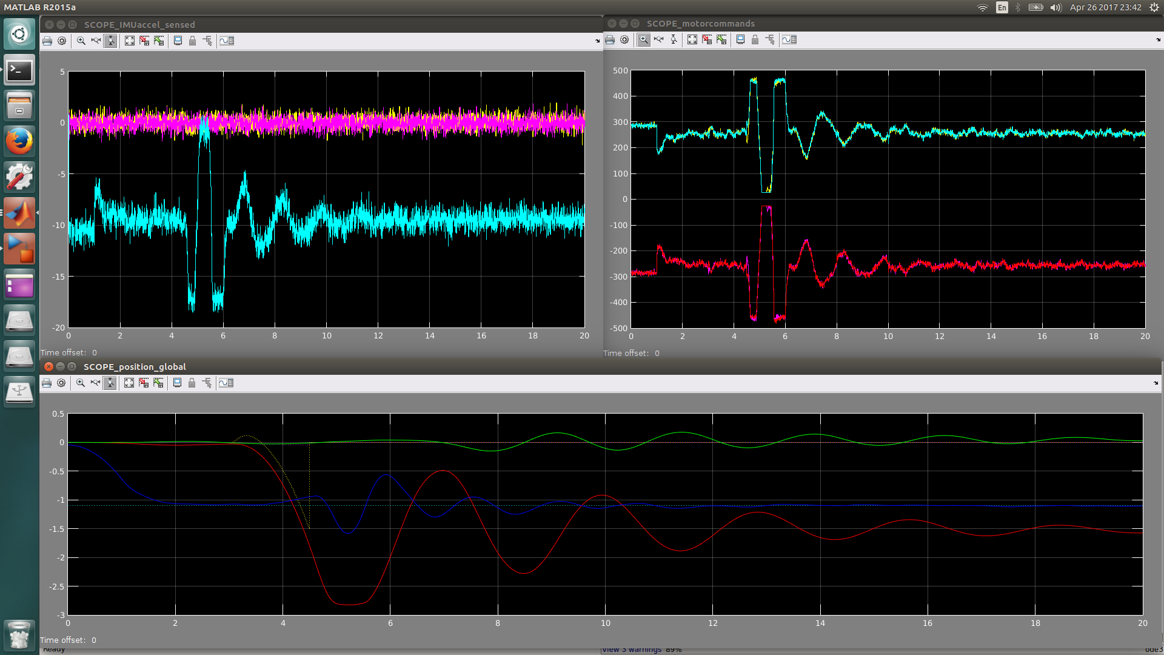
Results
Full State Feedback

Slide 12
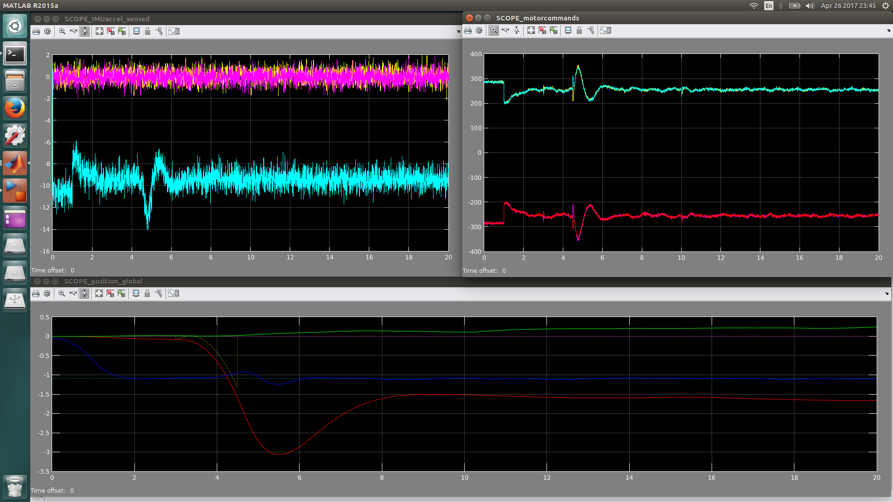
Results
LQR controller

Slide 13
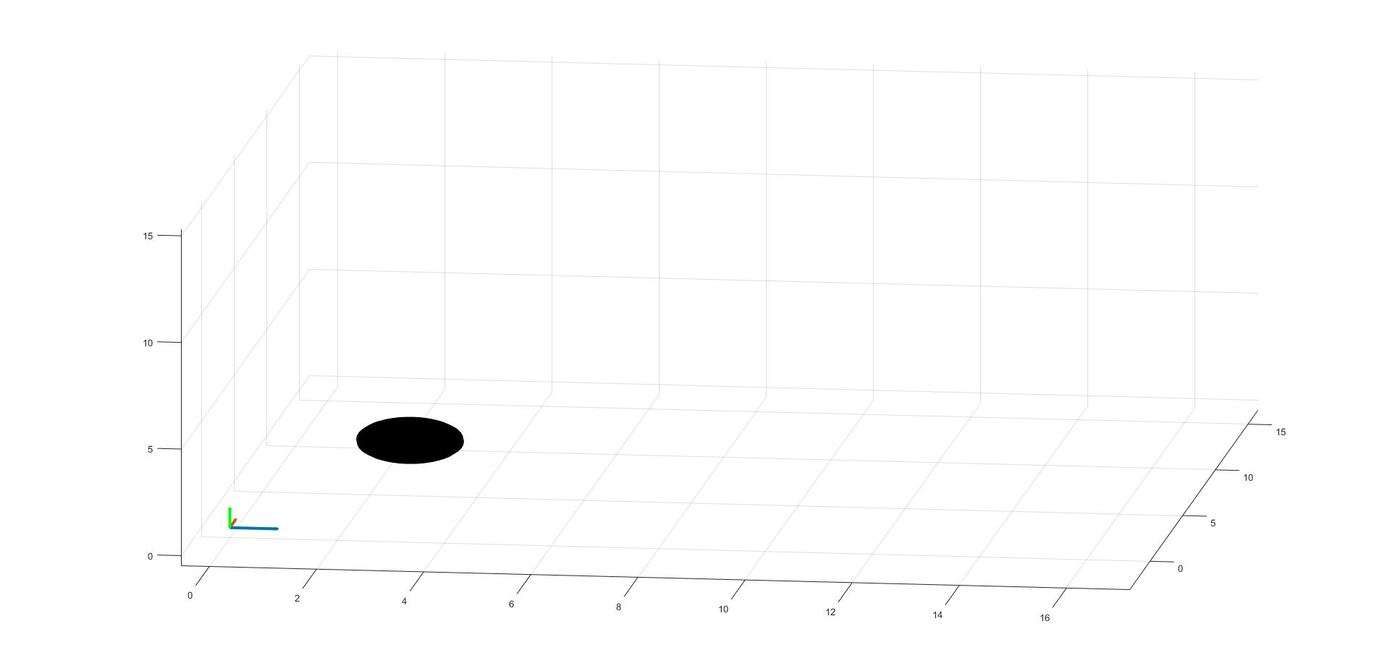
Results
F=ma
F
Geometric Controller with point mass

Slide 14
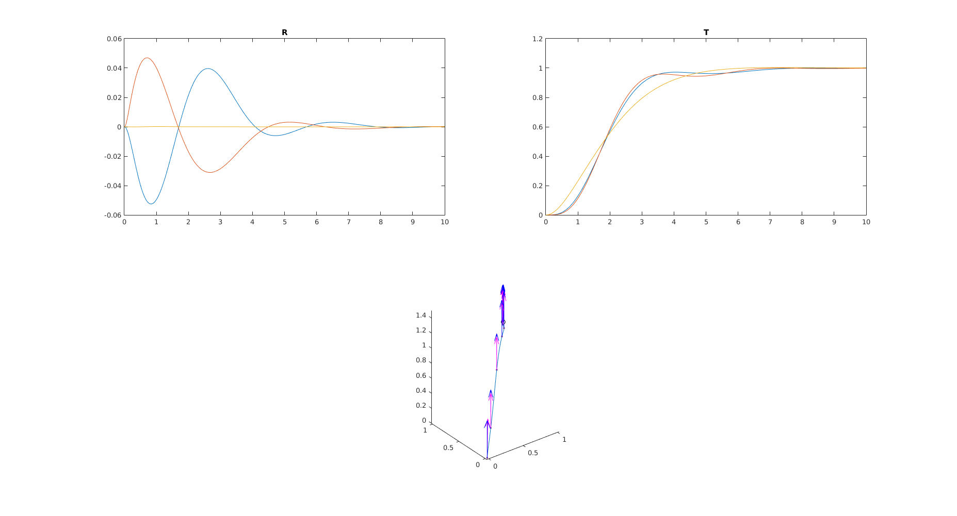
Results
Geometric Controller with point mass
Friction not taken into account.

Slide 15
Challenges I faced
Getting the drone to fly according to command without using optical flow (i.e., only sonar).
Design of simple controllers that integrated with existing Simulink model.
Battery only lasted for ~8 minutes for every 1 hour of charge.
Conversion of physical parameters to mathematical models.
Designing parameters for simulation of the geometric controller.

Slide 16
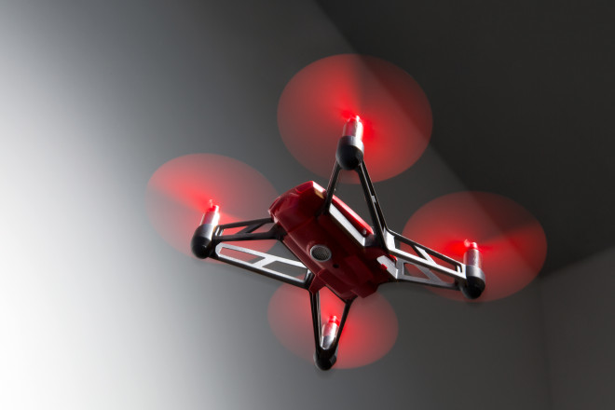
Future Work
Coding more efficiently.
Completing the model for the parrot drone.
Implementing both position and attitude control using this method to achieve exponential stability for all error angles.

Slide 17
Thank You

